Slide 1



Center Surround Research Update
Ian Cone
Shouval Lab
10/30/20

Slide 2
Purpose of Hippocampus?
“The hippocampus and its allied structures have been suggested to ‘encode’ a spatial map and, more recently, to ‘represent’ time. These theories lead to the postulates of place cells in the hippocampus, grid cells in the entorhinal cortex, and time cells in both structures.” (Buzsaki and Tingley 2018)
Are place cells and time cells distinct or are these subsets of a much larger computational umbrella?

Slide 3
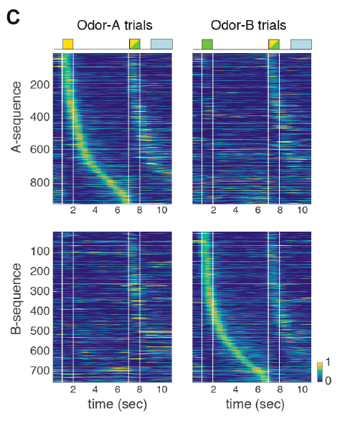
Hippocampal Encoding Scheme
Experiments suggest that characteristic cells in hippocampus (particularly CA1) respond to multiple contexts
ex: “place” cell that only fires in a certain place, while the animal is traveling a certain direction
Another ex: “time” cells which only fire at a particular time, if preceded by presentation a particular odor

Slide 4
Hippocampal Encoding Scheme
Experiments suggest that characteristic cells in hippocampus (particularly CA1) respond to multiple contexts
ex: “place” cell that only fires in a certain place, while the animal is traveling a certain direction
Another ex: “time” cells which only fire at a particular time, if preceded by presentation a particular odor

Slide 5
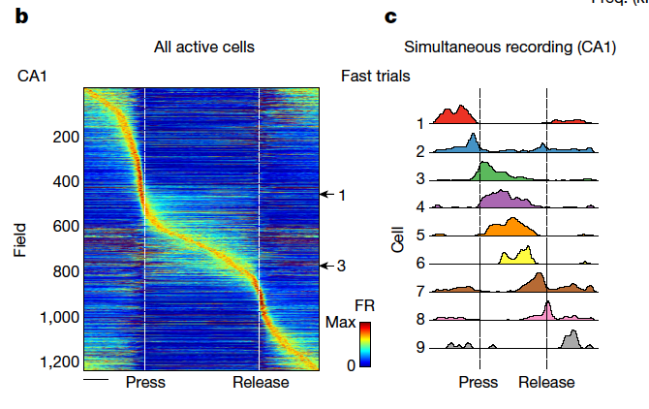
Hippocampal Encoding Scheme
Here, responsive cells are formed that respond discretely to different sound frequencies (via a press and release of a joystick along a continuous frequency axis).
“Neurons involved in this representation overlapped with the known spatial cell types in the circuit, such as place cells and grid cells.” (Arnov, Nevers, and Tank 2017)

Slide 6
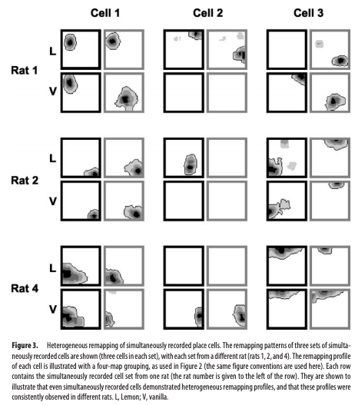
Hippocampal Encoding Scheme
Here, ”place cells” are measured across 4 different contexts (two possible odors, two possible tones of light) and show significant variation between contexts.
“Hippocampal place cells show spatially localized activity that can be modulated by both geometric information (e.g., the distances and directions of features in the environment) and nongeometric information (e.g., colors, odors, and possibly behaviors).” (Anderson and Jeffery 2003)

Slide 7
Purpose of Hippocampus?
Second hypothesis: Hippocampal CA3 takes inputs and creates spatiotemporal sequences unique to those inputs. These sequences are inputs to CA1.
In CA1, there are no “place cells” or “time cells”, strictly as such. Instead, a general class of “responsive cells” learns to map behaviorally relevant variables, through some sort of reward or instructive signal that co-occurs with a part of the CA3 sequence.

Slide 8
Some examples using Traditional and New Methods

Slide 9
Magee example
Animal is running along track, and at location x_0 receives a plateau potential in CA1 output cell
CA3 inputs themselves are explicitly place cells
Learning rule strengthens synapses with a presynaptic place field active during the plateau potential, and depresses others

Slide 10
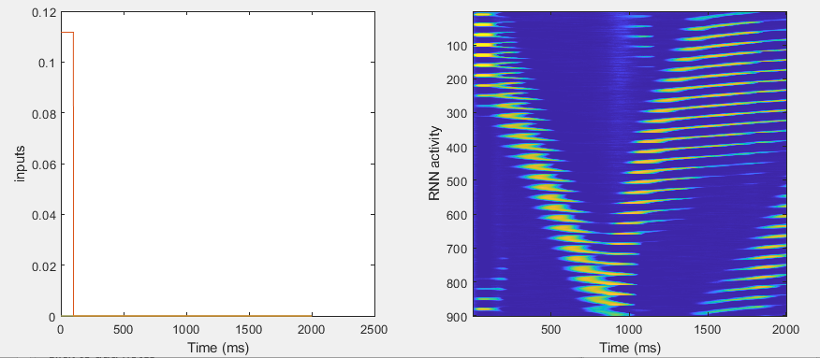
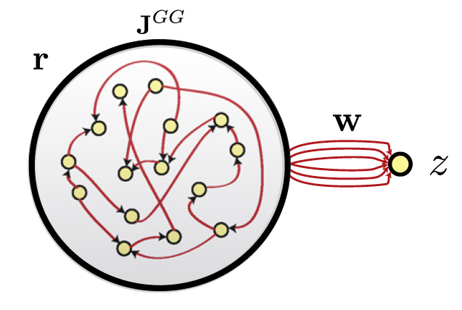
Magee ODOR example
CA3 Activity
Animal receives one of two odor puffs immediately prior to running. During running, at location x_0 a plateau potential is induced in CA1, but only following one of the odors
CA3 receives odor and position inputs and creates spatiotemporal outputs unique to the context & history
CA3
Odor
Position

Slide 11
Magee ODOR example
CA3 Activity
Learning rule strengthens synapses with presynaptic activity during the plateau potential
CA1 output fires at x_0, but only after the trained odor presentation.
The result is a “place + smell” cell, which behaves like a place field, but only following the trained odor presentation.
CA3
Odor
Position

Slide 12
Anderson and Jeffery 2003 example
Here, ”place cells” are measured across 4 different contexts (two possible odors, two possible tones of light) and show significant variation between contexts.
“Hippocampal place cells show spatially localized activity that can be modulated by both geometric information (e.g., the distances and directions of features in the environment) and nongeometric information (e.g., colors, odors, and possibly behaviors).” (Anderson and Jeffery 2003)

Slide 13
Anderson and Jeffery 2003 example
CA3 Activity
Here, ”place cells” are measured across 4 different contexts (two possible odors, two possible tones of light) and show significant variation between contexts.
“Hippocampal place cells show spatially localized activity that can be modulated by both geometric information (e.g., the distances and directions of features in the environment) and nongeometric information (e.g., colors, odors, and possibly behaviors).” (Anderson and Jeffery 2003)
CA3
Position
Odor
Light

Slide 14
How to create Effective CPG
Liquid state machines are often the go to tool for generation of complex and unique spatio-temporal signals for any given input
However, a) their internal states are not robust to noise, and b) the learning rules used (backprop) are biologically unrealistic.

Slide 15
How to create Effective CPG
CPG Activity
Instead, we propose a network with mixed center surround and random gaussian weights (and adaptation), which creates robust, long lasting spatiotemporal patterns which are unique to a given input

Slide 16
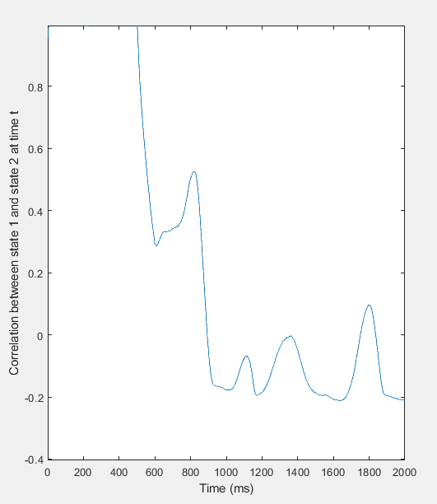
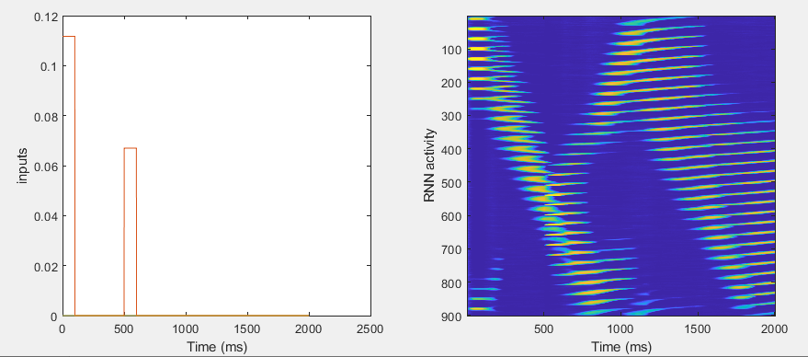
A
A-B

Slide 17
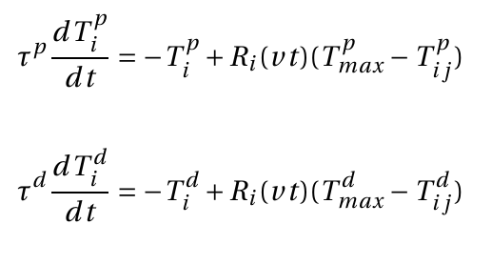
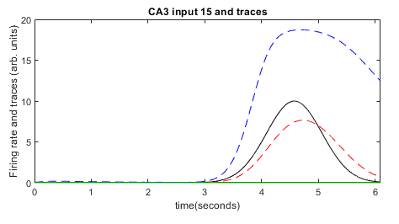
Learning in the CPG
Since the network creates a moving spatial bump, single neuron responses form gaussian-like responses in time, allowing us to use trace-based learning rule

Slide 18
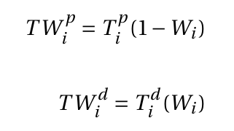
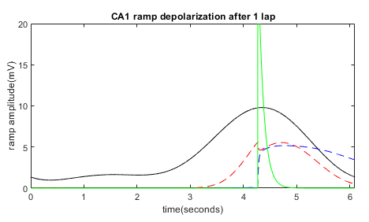

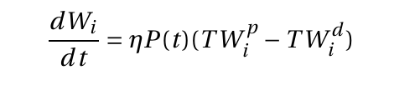
Instructive Signal and Weight updates

